Slide 1
The Digestive System
5Zx /ujhn
Notes:
Hope you enjoy

Slide 2
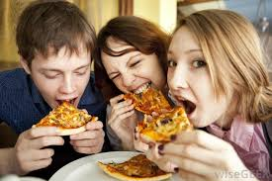
The Mouth
The food enter the mouth like this.

Slide 3
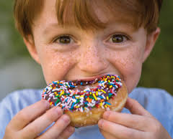
The molars crush the food
Like this.

Slide 4
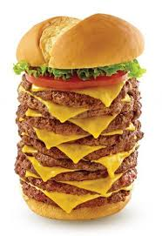
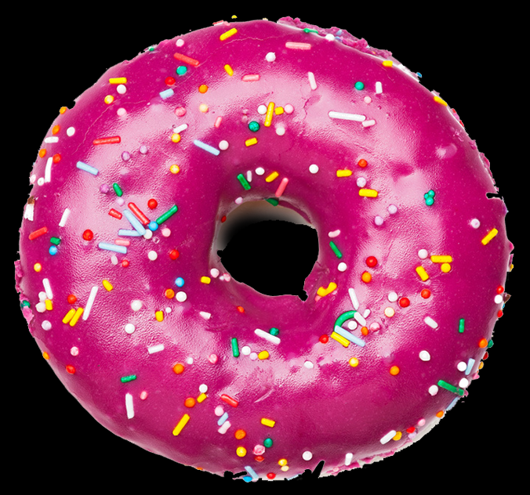
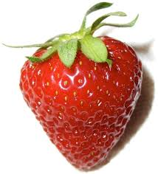
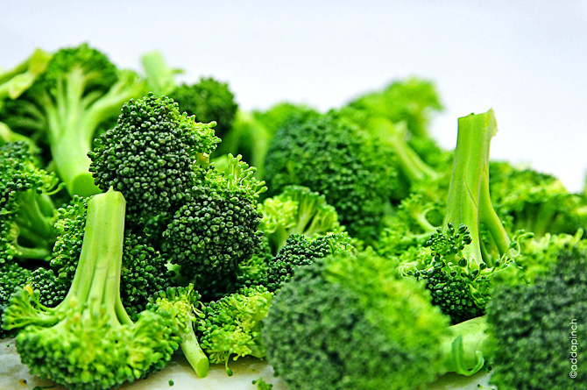
food
Look yummy!
Fatty foods
Healthy foods
Healthy

Slide 5
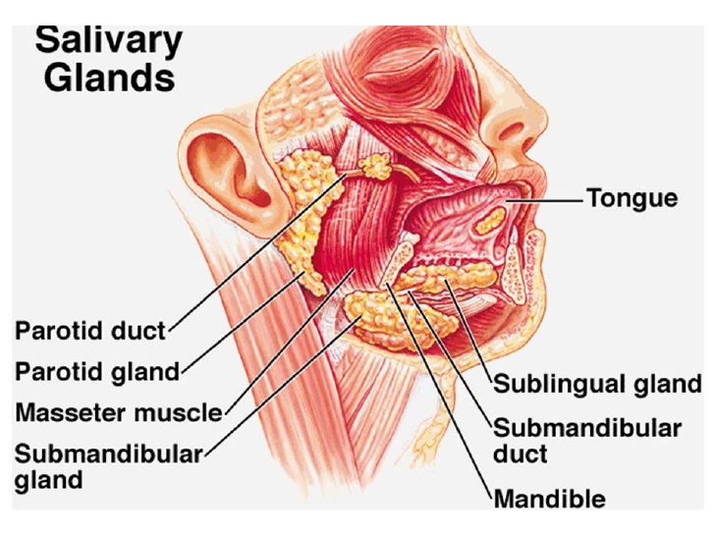
Saliva glands
Enzymes are in saliva and help their friends called the teeth by crushing it with them.

Slide 6
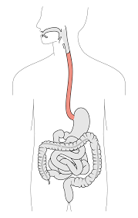
Oesophagus
It’s a tube that goes down your chest and contracts the food down your system.

Slide 7
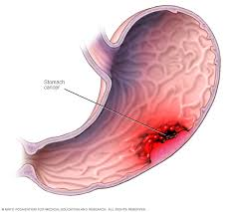
The stomach
The stomach hold a boiling acid called stomach acid it burns the crushed food like putting it in the microwave for to long.

Slide 8
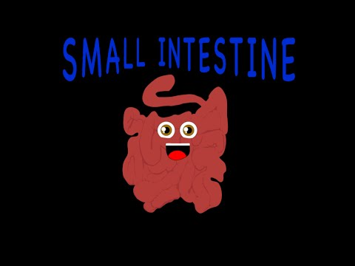
The small intestine
The small intestine is about 7 metres long in an adult but about 5 or 6 metres long for a child the food had a long long journey through the small intestine and it goes to the… large intestine.

Slide 9
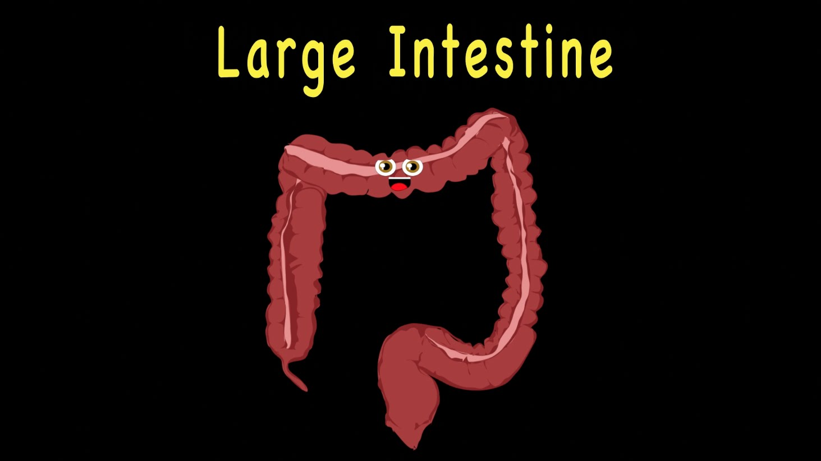
Large intestine
The large intestine is much shorter than the small intestine but its called the large intestine because its much thicker it soakes up the water in it.

Slide 10
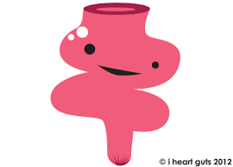
The rectum
The rectum is a place where faeces (poop) is stored before it come out of the anus
Poo is made of dead cells, bacteria and fibre

Slide 11
The ANUS
The anus is the bit the shoves all the rubbish which is poop if you sit on the loo and relax your anus you will be having a poo

