Slide 1
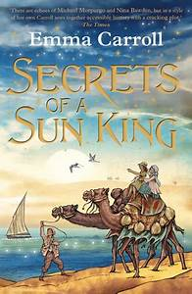
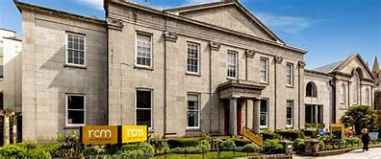
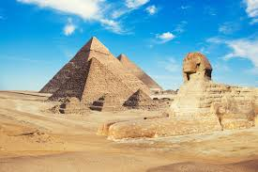
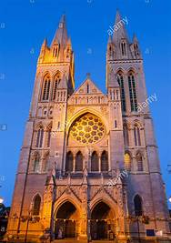
Egypt
Maths
Place value – numbers up to 10 million including numbers with 3 decimal places
Addition, subtraction, multiplication and division.
Shape and angles
Measures on Friday
Fractions
English
We will be reading Secrets of a Sun King by Emma Carroll. Through this book we will explore:
Historical fiction
Stories that raise issues
Letters
Instructions and explanations,
Recounts
We will be learning the Spelling, punctuation, and grammar that relates to these particular genres.
Poetry on Friday
Science 1
Research, investigate,
experiment, analyse results and present findings.
Light
We will find out about:
What are light sources?
How do we see things?
How does light travel?
How can we use mirrors to see round corners?
Can we bend light – if so, what happens?
Investigating colour.
Investigating shadows.
Spanish
Science 2
Animals including Humans
We will find out about:
The circulatory system – the heart, blood vessels and blood.
Recognise the impact of diet, exercise, drugs and lifestyle on the way our bodies function.
How nutrients are transported through our body.
An Egyptian workshop at the Royal Cornwall Museum.
Geography
Locate continents, the equator, the northern and southern hemispheres, the tropics.
Identify climate zones and look for patterns.
Locate Egypt on a word map.
Investigate the natural and man-made features of Egypt.
The River Nile
History
When did the Ancient Egyptians rule?
What can we tell about Ancient Egypt from objects that have survived?
What was life like in Ancient Egypt?
What did the Ancient Egyptians believe about gods and life after death?
Museum workshop.
Art and DT
The Colour wheel
Mixing colours including tints, tones and shades.
Using colour and line to create Optical Illusion art.
Painting an Egyptian landscape.
Explore Ancient Egypt through sculpture and collage – Researching, designing, making and evaluating the process.
RE – A visit to Truro Cathedral to find out about the importance of the building to people in Cornwall.
We will also be finding out about People of God - Moses
P.E
Netball
Games
Gym

